Slide 1
CSI ZG515/ SS ZG515 Data Warehousing
Swarna Chaudhary

Slide 2
Support for Data Warehousing in RDBMS/SQL

Slide 3
Support in RDBMS
Aggregation & Aggregate Navigator
Partitioning
Materialized Views
Bitmap Index & Bitmap Join Index
Dimensions
Online Aggregation
SQL Extensions

Slide 4
Aggregation & Aggregate Navigator
Most RDBMS now have support for aggregates in the form of Aggregate Navigator (AN)
Aggregates are the summarization of fact related data for the purpose of improved performance.
When to use:
when the number of detailed records to be processed is large and/or the processing of the customer queries begins to impact the performance

Slide 5
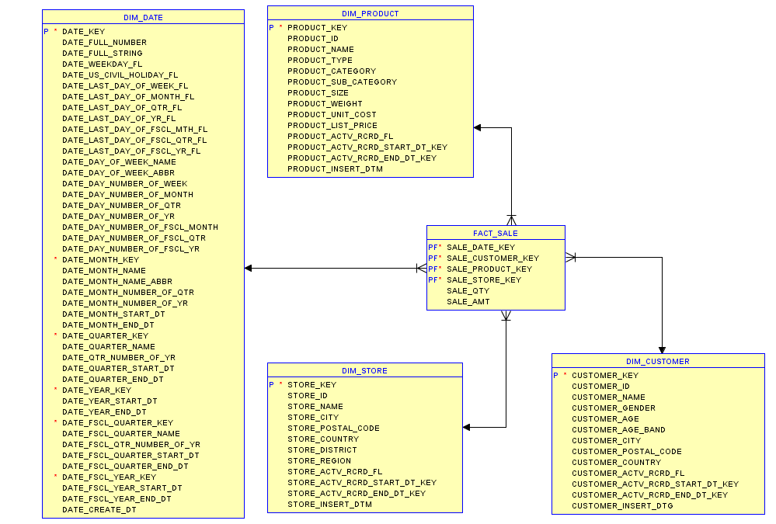
Example

Slide 6
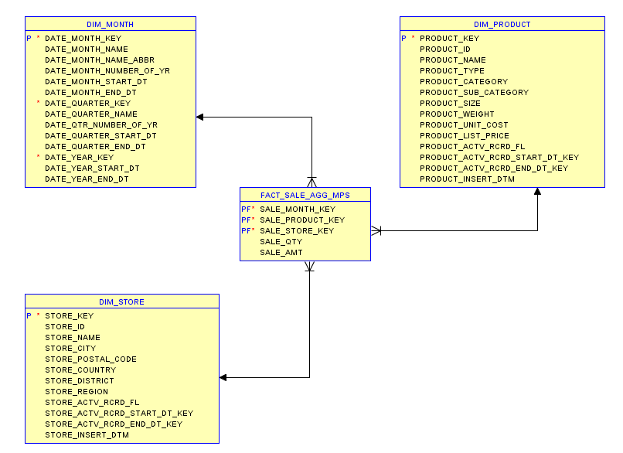
Aggregate Fact Table

Slide 7
Aggregation & Aggregate Navigator
AN helps them to improve performance of queries requiring aggregates and to match the performance of Multidimensional Databases
Aggregate Navigation Algorithm and metadata helps to target most suitable aggregate for a given query
Users/queries need not be aware of existing aggregates
Implemented using Materialized Views

Slide 8
Aggregate Navigator
Aggregate Navigator (AN) is the solution
So what is an AN?
A middleware sitting between user queries and DBMS
With AN, user applications speak just base level SQL
AN uses metadata to transform base level SQL into “Aggregate Aware” SQL

Slide 9
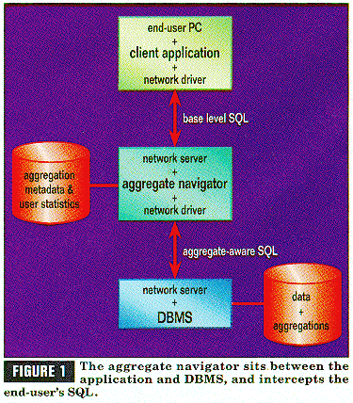
Figure taken from Kimball’s articles on Aggregate Navigator

Slide 10
Partitioning
Data warehouses often contain very large tables and require techniques both for managing these large tables and for providing good query performance across them
Partitioning is supported in most RDBMSs
Even if it is not supported, one can create them using the concept of views
Manually move data from the table to be partitioned to its partitions (tables)
Create a view using union of partitions, giving an illusion that the original table still exists

Slide 11
Types of Partitioning
Oracle offers four partitioning methods:
Range Partitioning
Hash Partitioning
List Partitioning
Composite Partitioning

Slide 12
Hash Partitioning
Distributes data evenly among the partitions/devices
Easy to use partitioning
Oracle uses a linear hashing algorithm to avoid skew
No. of partitions should be in powers of 2
Users cannot specify alternate hashing functions or algorithms

Slide 13
Hash Partitioning: Example
CREATE TABLE sales_hash
(salesman_id NUMBER(5),
salesman_name VARCHAR2(30),
sales_amount NUMBER(10),
week_no NUMBER(2))
PARTITION BY HASH(salesman_id)
PARTITIONS 4
STORE IN (data1, data2, data3, data4);

Slide 14
List Partitioning
List partitioning enables you to explicitly control how rows map to partitions.
Specify a list of discrete values for the partitioning column in the description for each partition.
Different from range partitioning, where a range of values is associated with a partition and with hash partitioning, where you have no control of the row-to-partition mapping
Advantage of list partitioning is that you can group and organize unordered and unrelated sets of data in a natural way

Slide 15
List Partitioning: Example
CREATE TABLE sales_list
(salesman_id NUMBER(5),
salesman_name VARCHAR2(30),
sales_state VARCHAR2(20),
sales_amount NUMBER(10),
sales_date DATE)
PARTITION BY LIST(sales_state)
(
PARTITION sales_west VALUES IN('California', 'Hawaii'),
PARTITION sales_east VALUES IN ('New York', 'Virginia', 'Florida'),
PARTITION sales_central VALUES IN('Texas', 'Illinois'),
);

Slide 16
Composite Partitioning
Composite partitioning combines range and hash partitioning.
First distribute data into partitions according to boundaries established by the partition ranges.
Then use a hashing algorithm to further divide the data into sub-partitions within each range partition

Slide 17
Materialized Views
Materialized views are supported in most RDBMSs
A materialized view, is a table segment whose contents are periodically refreshed based on a query
Types of Materialized views supported*
With aggregates
With joins
With both joins & aggregates
Nested materialized views

Slide 18
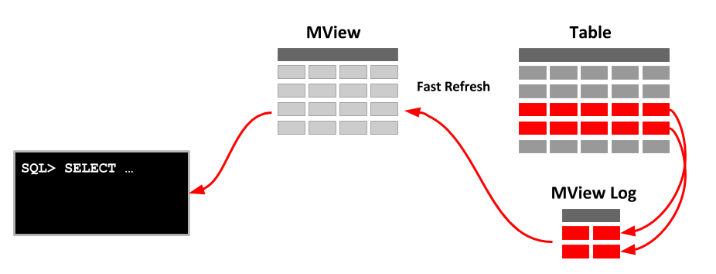
Materialized View

Slide 19
Materialized Views - Aggregates
CREATE MATERIALIZED VIEW view-name
BUILD [IMMEDIATE | DEFFERED]
REFRESH [FAST | COMPLETE | FORCE ]
ON [COMMIT | DEMAND ]
[[ENABLE | DISABLE] QUERY REWRITE]
AS
SELECT ...;
The BUILD clause options are:
IMMEDIATE : The materialized view is populated immediately.
DEFERRED : The materialized view is populated on the first requested refresh.
The following refresh types are available.
FAST : A fast refresh is attempted.
COMPLETE : The table is repopulated completely using the associated query.
FORCE : A fast refresh is attempted. If one is not possible a complete refresh is performed.
A refresh can be triggered in one of two ways.
ON COMMIT : The refresh is triggered by a committed data change in one of the dependent tables.
ON DEMAND : The refresh is initiated by a manual request or a scheduled task.
The QUERY REWRITE clause tells the optimizer if the materialized view should be consider for query rewrite operations.

Slide 20
Materialized Views - Aggregates
CREATE MATERIALIZED VIEW LOG ON sales WITH SEQUENCE, ROWID
(prod_id, cust_id, time_id, channel_id, promo_id, quantity_sold, amount_sold)
INCLUDING NEW VALUES;
CREATE MATERIALIZED VIEW sum_sales
PARALLEL
BUILD IMMEDIATE
REFRESH FAST ON COMMIT AS
SELECT s.prod_id, s.time_id, COUNT(*) AS count_grp,
SUM(s.amount_sold) AS sum_dollar_sales,
COUNT(s.amount_sold) AS count_dollar_sales,
SUM(s.quantity_sold) AS sum_quantity_sales,
COUNT(s.quantity_sold) AS count_quantity_sales
FROM sales s
GROUP BY s.prod_id, s.time_id;

Slide 21
Materialized Views - Aggregates
This example creates a materialized view that contains aggregates on a single table
Because the materialized view log has been created with all referenced columns in the materialized view's defining query, the materialized view is fast refreshable
If DML is applied against the sales table, then the changes are reflected in the materialized view when the commit is issued.

Slide 22
Bitmap Indexes
Bitmap indexes are widely used in data warehousing environments which typically have large amounts of data and ad hoc queries
For such applications, bitmap indexing provides:
Reduced response time for large classes of ad hoc queries
Reduced storage requirements compared to other indexing techniques
Dramatic performance gains even on hardware with a relatively small number of CPUs or a small amount of memory
Fully indexing a large table with a traditional B-tree index can be prohibitively expensive in terms of space because the indexes can be several times larger than the data in the table
Bitmap indexes are typically only a fraction of the size of the indexed data in the table.
A regular index stores a list of rowids for each key corresponding to the rows with that key value
Bitmap Index uses a bitmap for each key value replaces a list of rowids
Most effective for queries that contain multiple conditions in the WHERE clause, conditions are filtered out before the table itself is accessed.

Slide 23
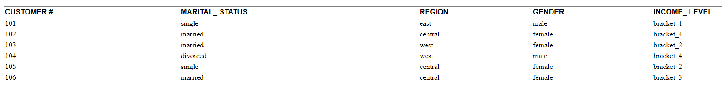
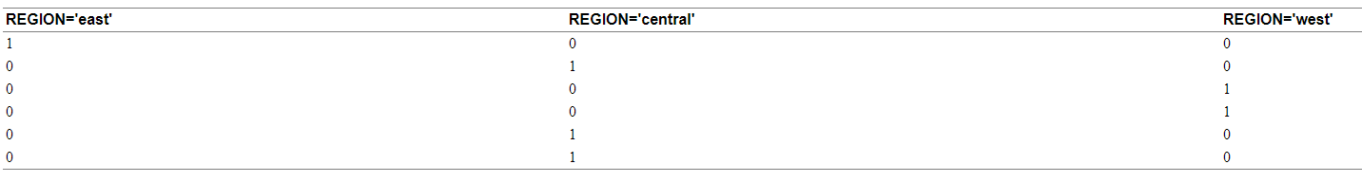
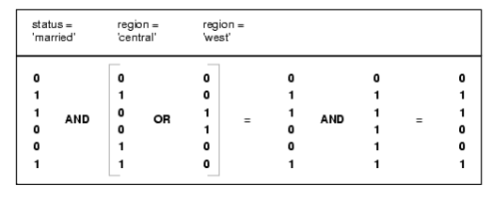
Bitmap Indexes
SELECT COUNT(*)
FROM customer
WHERE MARITAL_STATUS = 'married' AND REGION IN ('central','west');

Slide 24
Bitmap Join Indexes
In addition to a bitmap index on a single table, you can create a bitmap join index (BJI), which is a bitmap index for the join of two or more tables.
A BJI is a space efficient way of reducing the volume of data that must be joined by performing restrictions in advance.
For each value in a column of a table, a bitmap join index stores the rowids of corresponding rows in one or more other tables.

Slide 25
Bitmap Join Indexes
CREATE BITMAP INDEX cust_sales_bji
ON sales(customers.state)
FROM sales, customers
WHERE sales.cust_id = customers.cust_id;
Since the CUSTOMERS.STATE column is referenced in the ON clause of the index, queries on the SALES table that join to the CUSTOMERS table to retrieve the STATE column can do so without referencing the CUSTOMERS table. Instead the data is read from the bitmap join index.
SELECT SUM(sales.dollar_amount)
FROM sales, customer
WHERE sales.cust_id = customer.cust_id
AND customer.state = 'California';
When dealing with large datasets, this reduction in processing can be substantial.

Slide 26
Dimensions
In Oracle Database, the dimensional information itself is stored in a dimension table.
In addition, the database object dimension helps to organize and group dimensional information into hierarchies.
This represents natural 1:n relationships between columns or column groups (the levels of a hierarchy) that cannot be represented with constraint conditions

Slide 27
Dimensions
Before you can create a dimension object, the dimension tables must exist in the database possibly containing the dimension data
You create a dimension using the CREATE DIMENSION statement

Slide 28
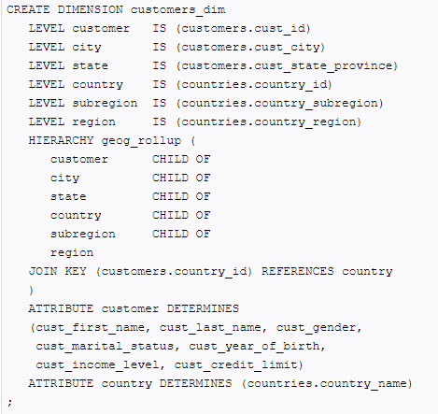
Dimension Example

Slide 29
SQL – New Operators for DW

Slide 30
SQL
Rollup
Cube
Window Queries
Top N Queries

Slide 31
SQL
Typically, a single OLAP operation can lead to several closely related SQL queries with aggregation and grouping
Cross-tabulation is an example!

Slide 32
Cube Operator
Locid | City | State | Country
1 | Madison | WI | USA
2 | Fresno | CA | USA
5 | Chennai | TN | India
pid | timeid | Locid | sales
11 | 1 | 1 | 25
11 | 2 | 1 | 8
11 | 3 | 1 | 15
12 | 1 | 1 | 30
12 | 2 | 1 | 20
12 | 3 | 1 | 50
13 | 1 | 1 | 8
13 | 2 | 1 | 10
13 | 3 | 1 | 10
11 | 1 | 2 | 35
11 | 2 | 2 | 22
11 | 3 | 2 | 10
12 | 1 | 2 | 26
12 | 2 | 2 | 45
12 | 3 | 2 | 20
13 | 1 | 2 | 20
13 | 2 | 2 | 40
13 | 3 | 2 | 5
Pid | Pname | category | Price
11 | Lee Jeans | Apparel | 25
12 | Zord | Toys | 18
13 | Biro Pen | Stationery | 2
Timeid | Date | Month | Year | Holiday
1 | 10/11/05 | Nov | 1995 | N
2 | 11/11/05 | Nov | 1996 | N
3 | 12/11/05 | Nov | 1997 | N

Slide 33
Cube Operator
Select T.year, L.state, SUM (sales)
from Sales S, Times T, Locations L
Where S.timeid=T.timeid & S.locid=L.locid
Group By T.year, L.state
 | WI | CA | Total
1995 | 63 | 81 | 144
1996 | 38 | 107 | 145
1997 | 75 | 35 | 110
Total | 176 | 223 | 399
Select T.year, SUM (sales)
from Sales S, Times T
Where S.timeid=T.timeid
Group By T.year
Select SUM (sales)
from Sales S, Locations L
Where S.locid=L.locid
OR
Select L.state, SUM (sales)
from Sales S, Locations L
Where S.locid=L.locid
Group By L.state
Select SUM (sales)
from Sales S, Time T
Where S.timeid=T.timeid
How many such SQL queries to build cross-tab?

Slide 34
SQL
Cross-tab can be thought of as a roll-up on the entire dataset, on location, on time, and on both location and time dimensions together
Each roll-up corresponds to a single SQL query with grouping
Given a FACT with k associated dimensions, we will have a total of 2^{k} such SQL queries

Slide 35
SQL
GROUP BY construct is extended to provide better support for roll-up and cross-tabulation queries
Collection of GROUP BY statement is equivalent to GROUP BY with CUBE keyword, with one GROUP BY statement for each subset of the k dimensions

Slide 36
Cube Operator
Select T.year, L.state, SUM (sales)
from Sales S, Times T, Locations L
Where S.timeid=T.timeid & S.locid=L.locid
Group By CUBE (T.year, L.state)
T.Year | L.State | SUM(sales)
1995 | WI | 63
1995 | CA | 81
1995 | All | 144
1996 | WI | 38
1996 | CA | 107
1996 | All | 145
1997 | WI | 75
1997 | CA | 35
1997 | All | 110
All | WI | 176
All | CA | 223
All | All | 399
 | WI | CA | Total
1995 | 63 | 81 | 144
1996 | 38 | 107 | 145
1997 | 75 | 35 | 110
Total | 176 | 223 | 399

Slide 37
Rollup Operator
Select T.year, L.state, SUM (sales)
from Sales S, Times T, Locations L
Where S.timeid=T.timeid & S.locid=L.locid
Group By ROLLUP (T.year, L.state)
T.Year | L.State | SUM(sales)
1995 | WI | 63
1995 | CA | 81
1995 | All | 144
1996 | WI | 38
1996 | CA | 107
1996 | All | 145
1997 | WI | 75
1997 | CA | 35
1997 | All | 110
All | All | 399
 | WI | CA | Total
1995 | 63 | 81 | 144
1996 | 38 | 107 | 145
1997 | 75 | 35 | 110
Total | 176 | 223 | 399
Find out wht the following SQL will generate?
Select T.year, L.state, SUM (sales)
from Sales S, Times T, Locations L
Where S.timeid=T.timeid & S.locid=L.locid
Group By ROLLUP (L.state, T.year)

Slide 38
Q & A

Slide 39
Thank You

